Slide 1







Understanding attitudes, experience and risk factors for domestic violence
International Team of Scientists working at JAMSTEC, Japan
Prima Anugerahanti
Indonesia
Gerlien Verhaegen
Belgium
Heather Ritchie
Scotland
Arthur Bauville
France
Ettore Barbieri
Italy

Slide 2

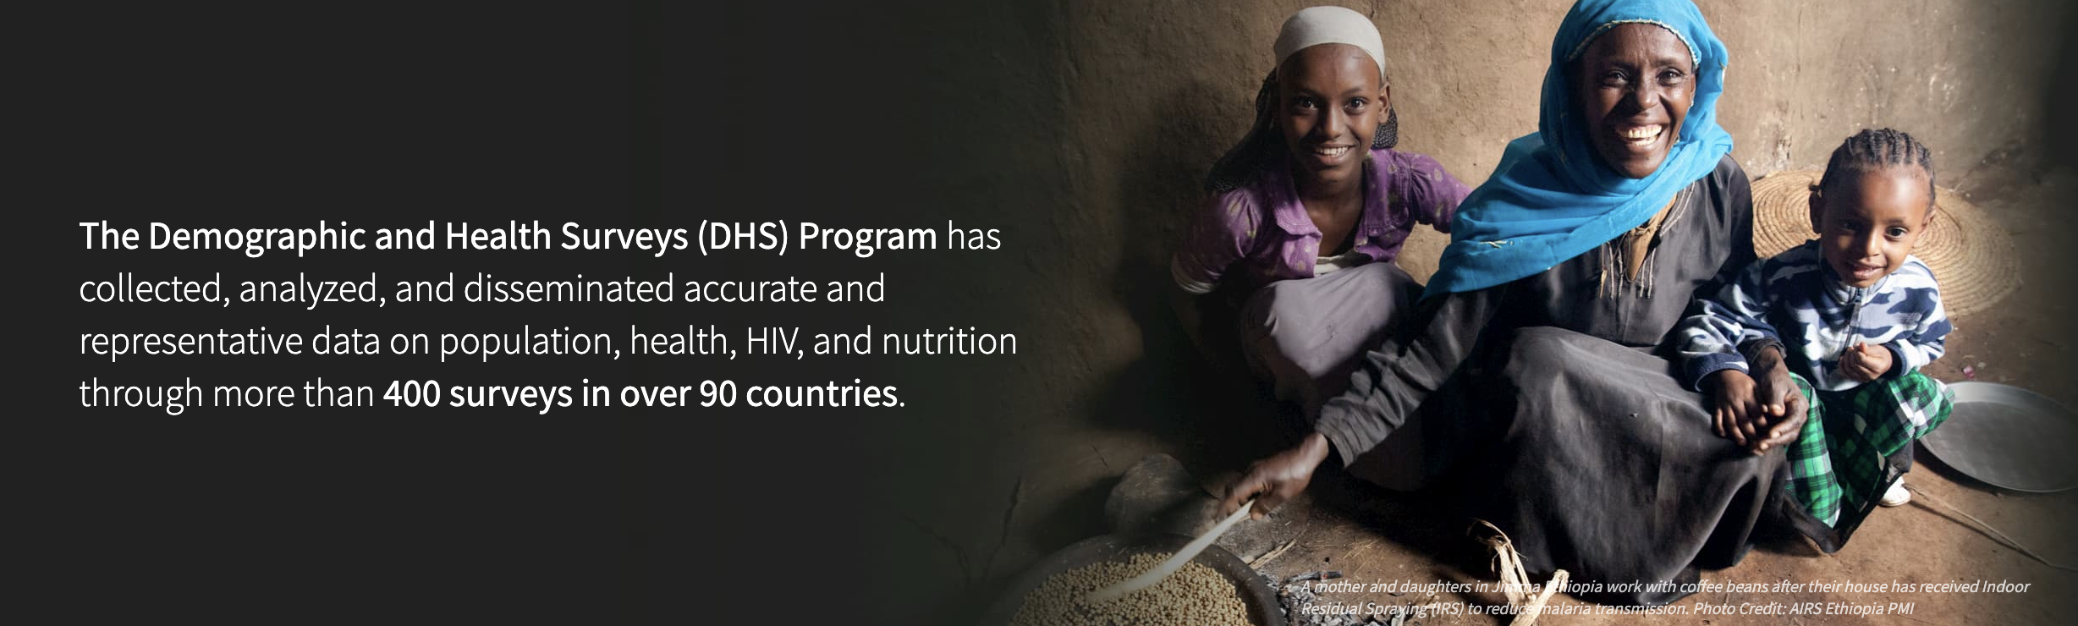
Using data provided by the DHS Program we wanted to:
Investigate the acceptance vs the experience of domestic violence
Determine the controlling factors of domestic violence
Develop a tool that would quickly and efficiently identify women who are at risk of domestic violence

Slide 3
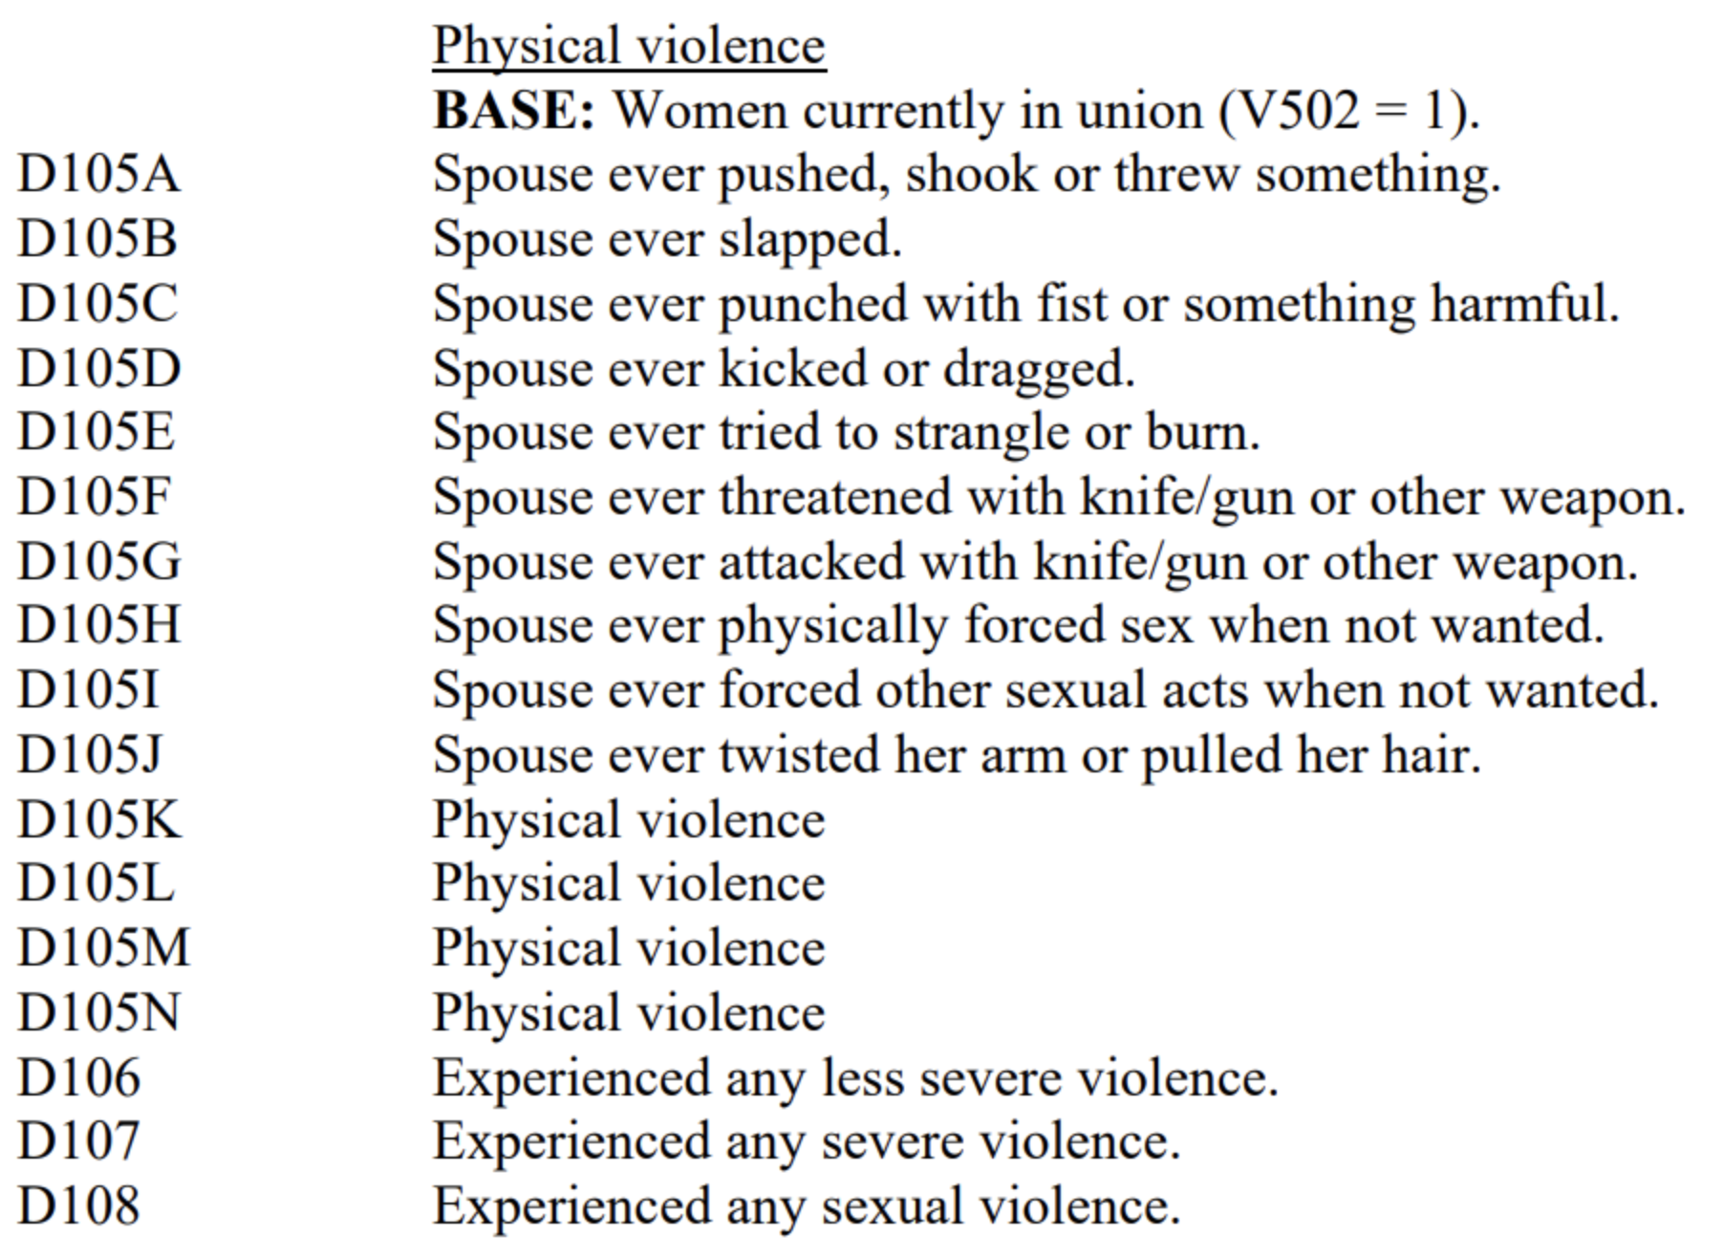
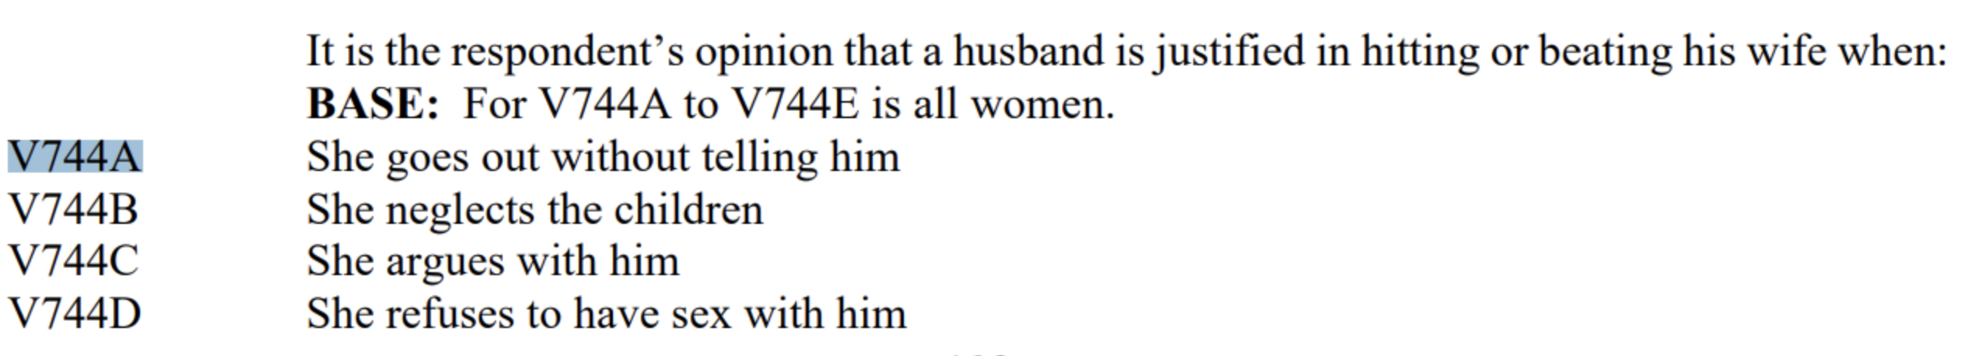
DHS Program data for acceptance and experience of domestic violence
Acceptance: % of yes to at least one answer of:
Experience: % of yes to at least one answer of:

Slide 4
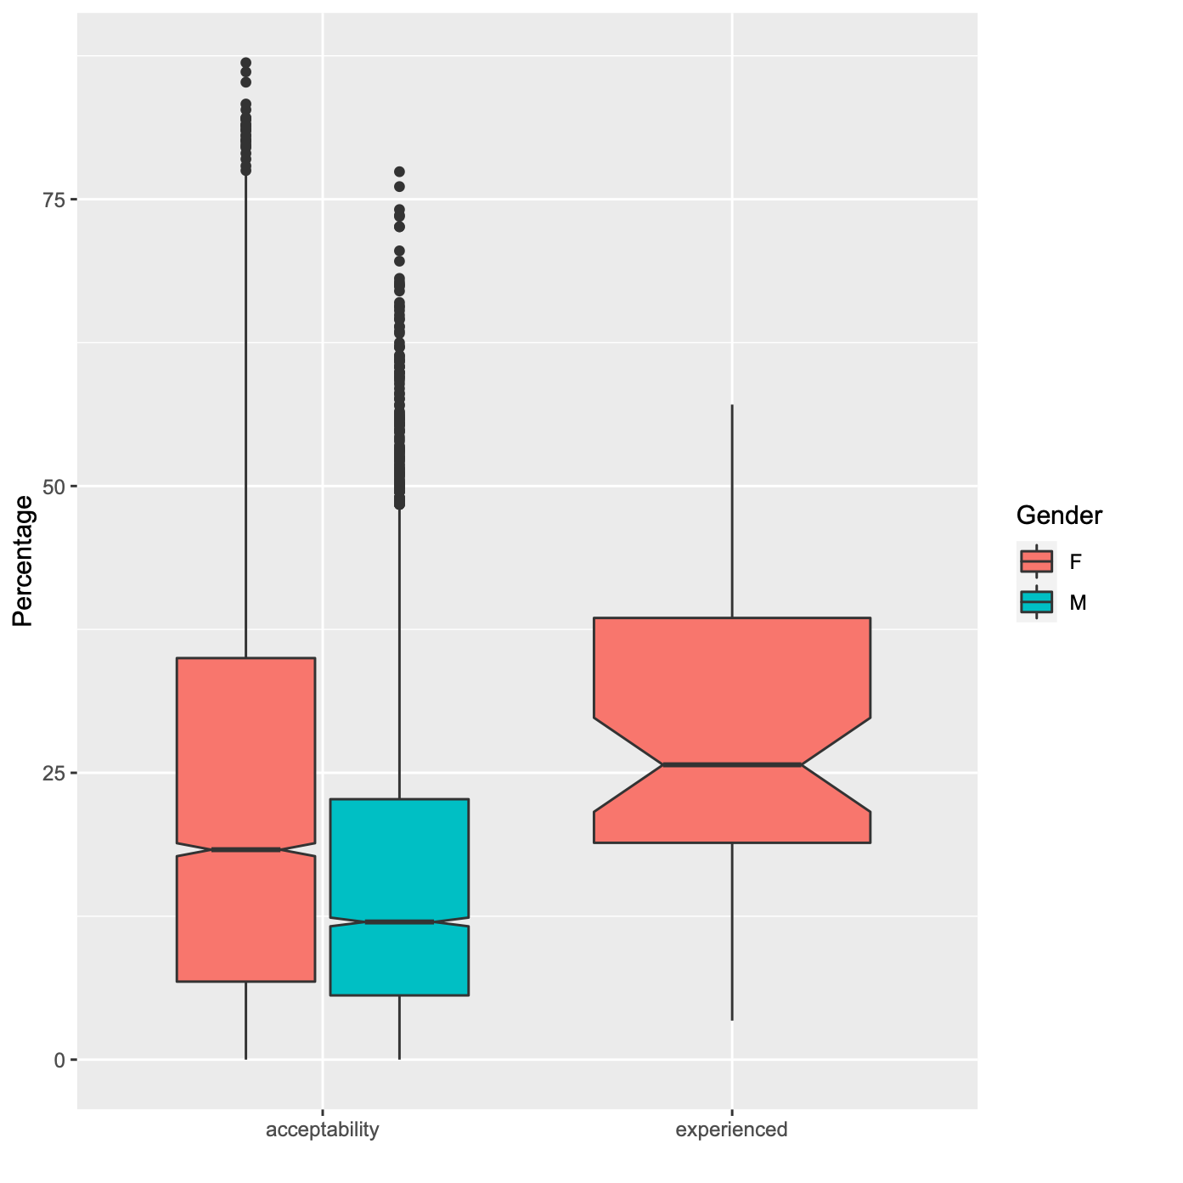
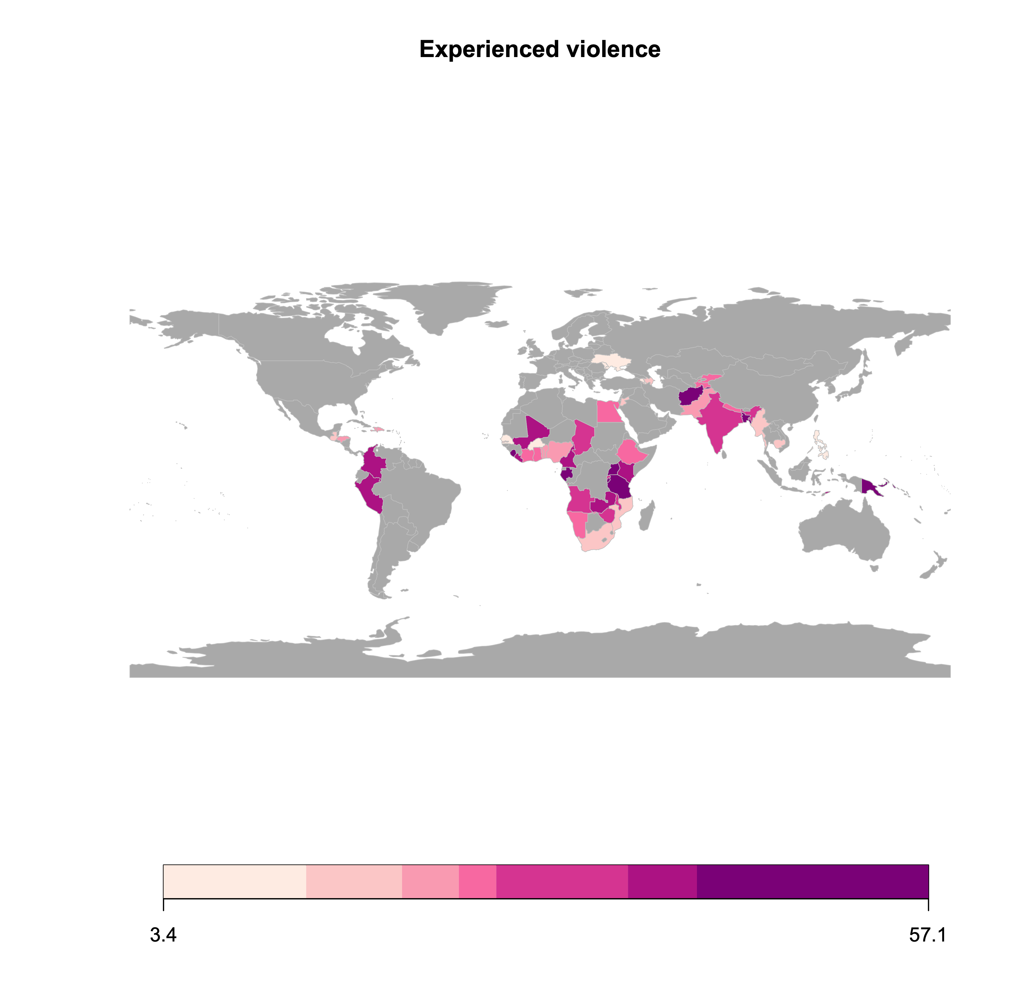
Acceptance vs experience of domestic violence
Domestic violence is widespread amongst the countries surveyed by the DHS
On average across all countries 26% of women surveyed have experienced physical and/or sexual domestic violence
Overall more women than men agreed that domestic violence was acceptable in certain circumstance

Slide 5
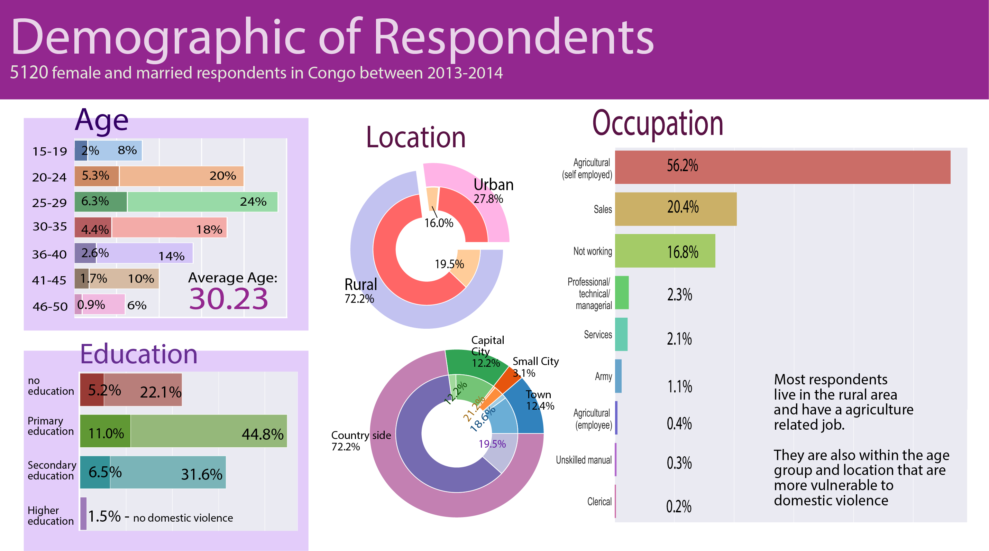

Slide 6

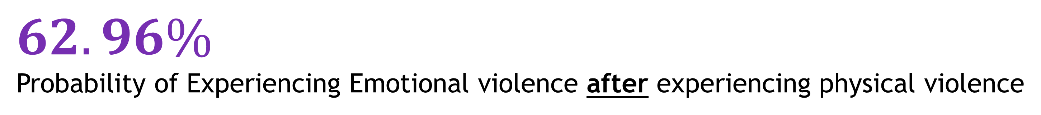
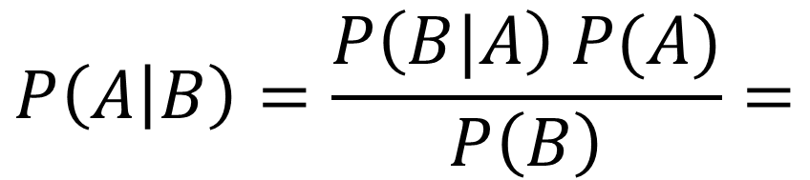
Probabilities for experiencing types of domestic violence
Received Physical Violence 4.52%
Received Emotional Violence 9.94%
Case Study 1 - BENIN
Received Both
2.84%
$$62.96\%$$
Probability of Experiencing Emotional violence after experiencing physical violence
$$P\left(B | A\right)=\frac{P\left(A∩B\right)}{P\left(A\right)}=$$
BAYES’ Theorem
28.61%
Probability of Experiencing physical violence after experiencing emotional violence
$$P\left(A | B\right)=\frac{P\left(B|A\right) P(A)}{P\left(B\right)}=$$

Slide 7


Probabilities for accepting types of domestic violence
Think Violence is Acceptable 31.6%
Received Emotional Violence 9.94%
Think Violence is Acceptable 31.6%
Received
Physical Violence 4.52%
Case Study 1 - BENIN
$$40.62\%$$
Probability of Accepting violence after experiencing emotional violence
$$47.09\%$$
Probability of Accepting violence after experiencing physical violence

Slide 8

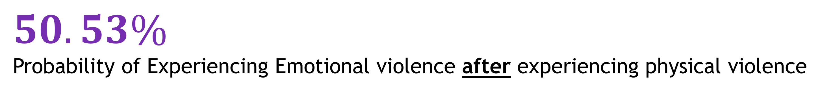
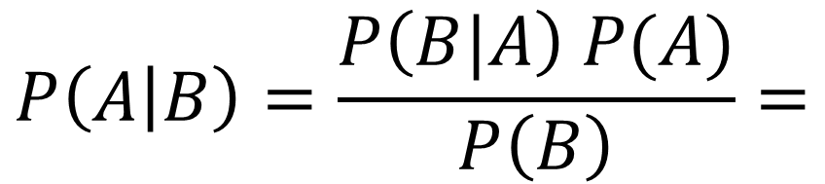
Probabilities for experiencing types of domestic violence
Received Physical Violence 18.52%
Received Emotional Violence
14.02%
Case Study 2 - CONGO
Received Both
9.36%
$$50.53\%$$
Probability of Experiencing Emotional violence after experiencing physical violence
$$P\left(B | A\right)=\frac{P\left(A∩B\right)}{P\left(A\right)}=$$
BAYES’ Theorem
66.71%
Probability of Experiencing physical violence after experiencing emotional violence
$$P\left(A | B\right)=\frac{P\left(B|A\right) P(A)}{P\left(B\right)}=$$

Slide 9


Probabilities for accepting types of domestic violence
Think Violence is Acceptable 75.49%
Received Emotional Violence 14.02%
Case Study 2 - CONGO
Think Violence is Acceptable 75.49%
Received
Physical Violence 18.52%
$$86.63\%$$
Probability of Accepting violence after experiencing emotional violence
$$87.24\%$$
Probability of Accepting violence after experiencing physical violence

Slide 10



Can we use these data to predict which women are at most risk of future violence?

Slide 11
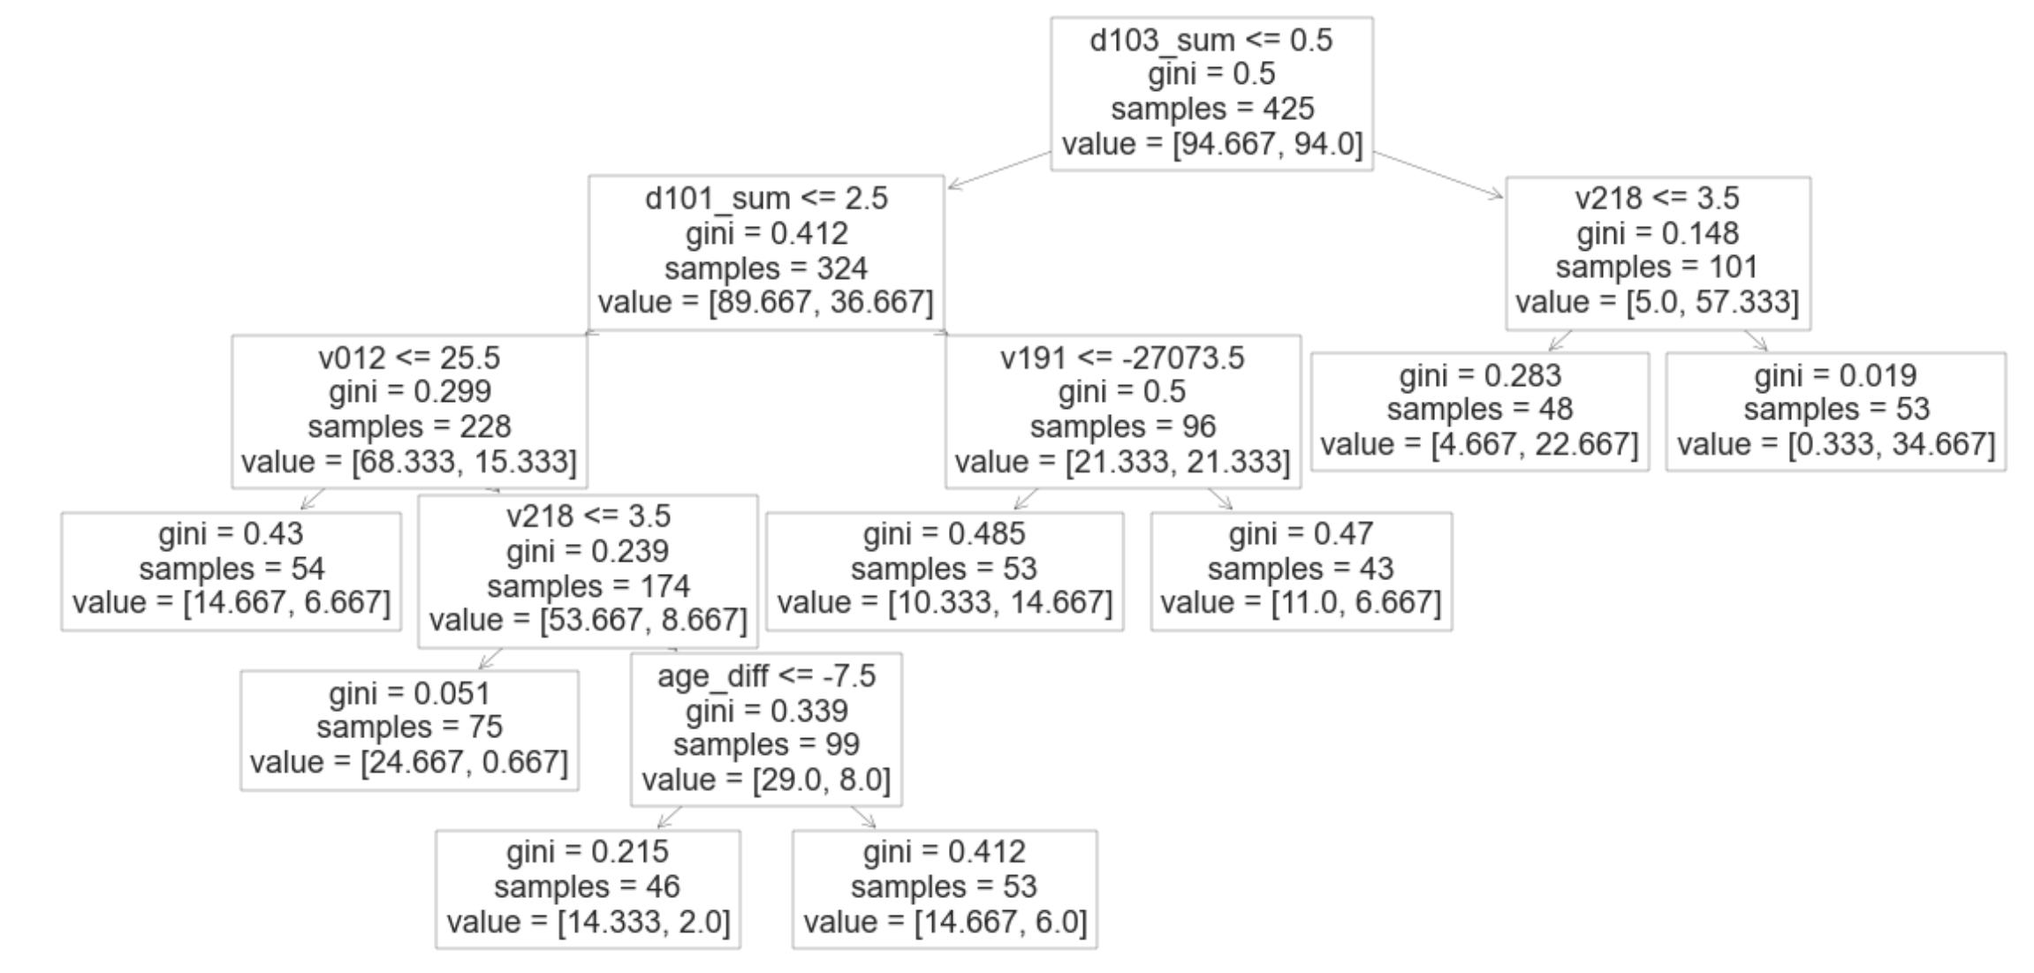
Diagnostic AI-tool
Of course the final graph will be cleaner
We aim to predict whether a woman is susceptible to experience domestic violence
We want a diagnostic test that can be performed in less than two minutes either automatically, on paper, or given by a non-expert.
We chose a decision-tree for its “white-box” approach. The decision-tree proposes a short series of questions. Each new question is personalized in function of the previous answer, so that the size of the questionnaire can be really small.
We obtain reasonnably good results by asking less than five questions

Slide 12
Conclusion

